Slide 3
Vaswani et al (2017), Attention Is All You Need.

Slide 4
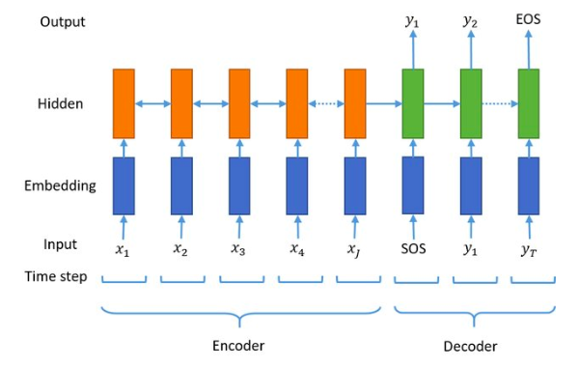
y_true
Fig. The casic seq2seq model. SOS and EOS represent the start and end of a sequence, respectively.

Slide 5
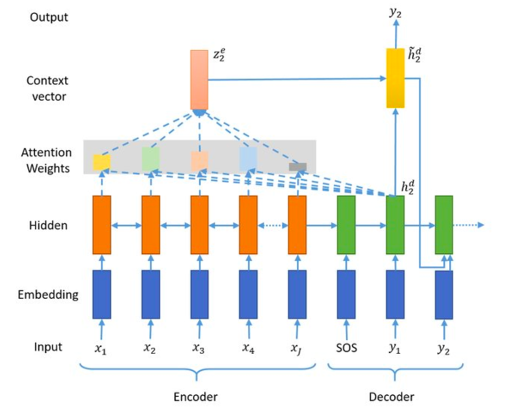
Fig. An attention-based seq2seq model.

Slide 6
POSITIONAL ENCODING
CUSTOM LEARNING RATE SCHEDULER

Slide 7
我用的attentions 是 transformer——基础是self-attention 包含（multi-head attention 和 dot-product attention） 还有 Bahdanau attention （又叫additive attention）and Luong attention (also called dot-product attention)
baseline 是 LSTM-LSTM seq2seq

